Slide 1
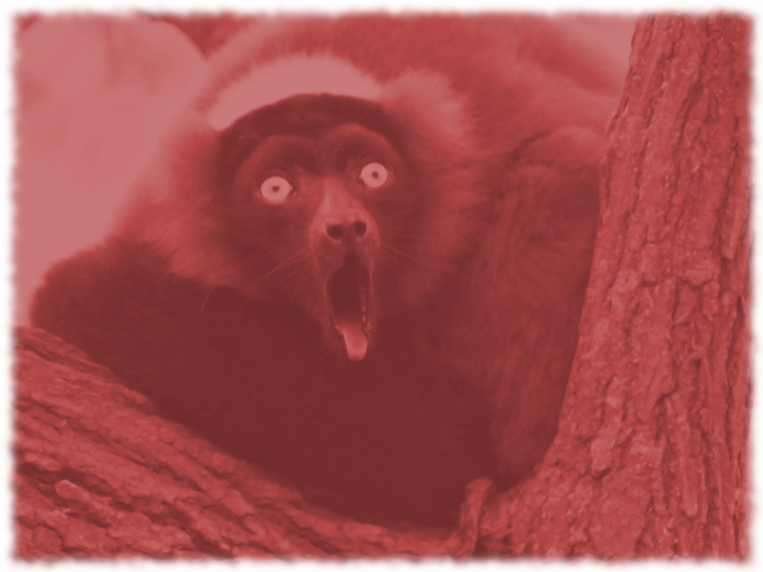
Red Lemur Sprint 2 Plans
Team Red Lemur

Slide 2
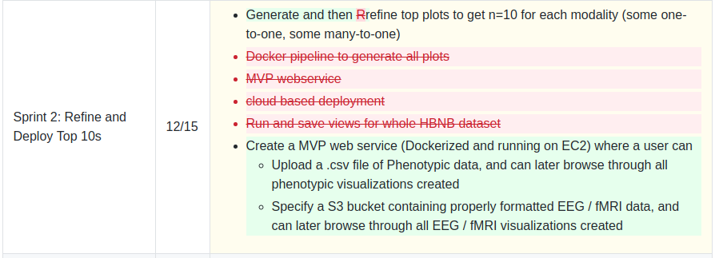
Sprint 2 Plans Refined

Slide 3
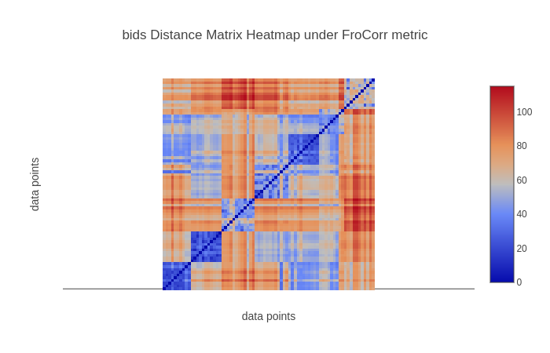
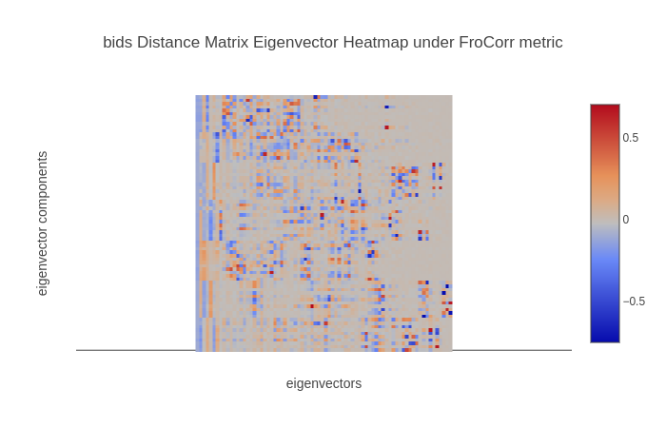
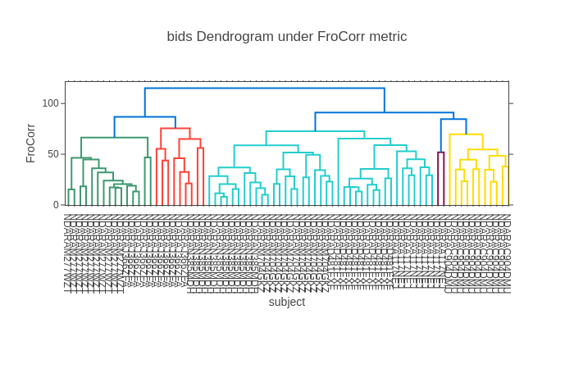
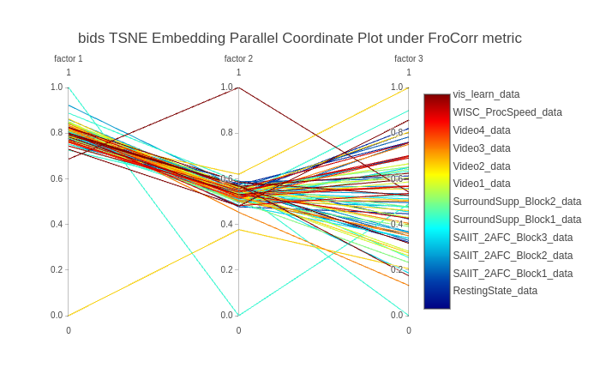
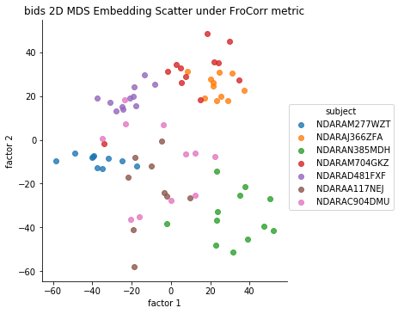
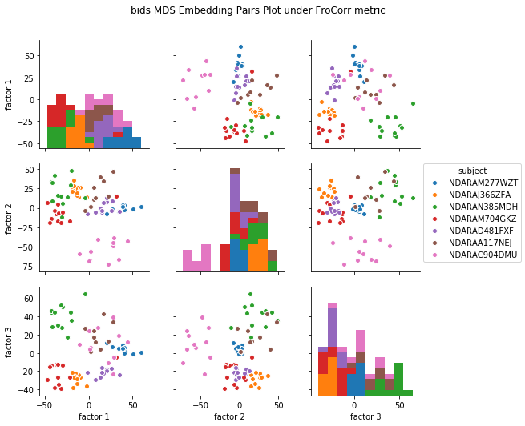
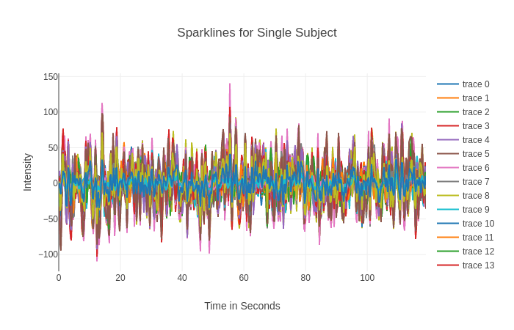
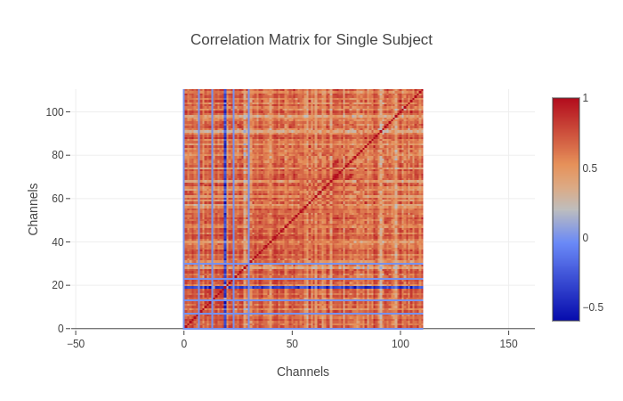
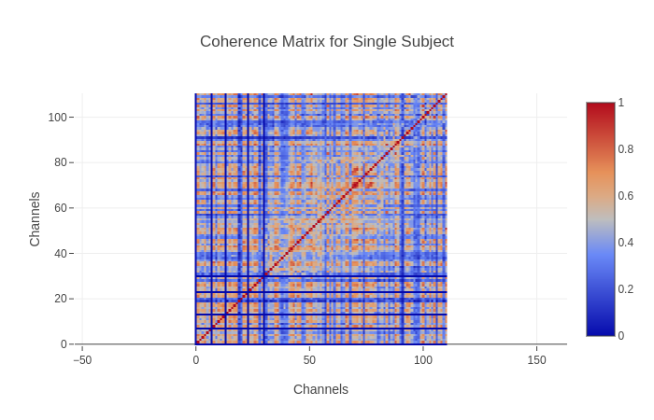
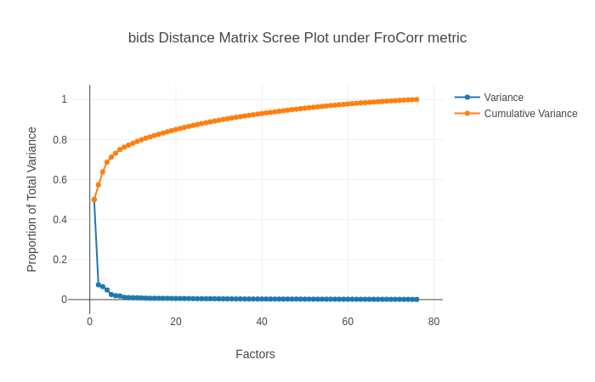
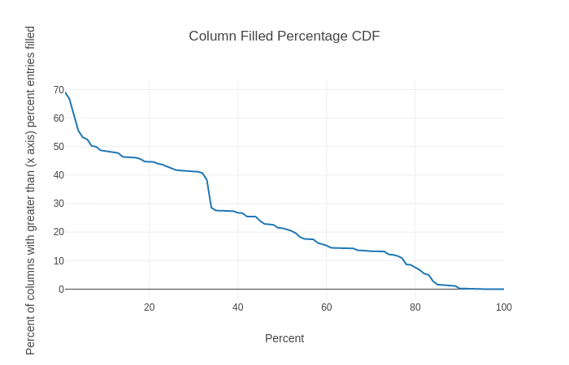
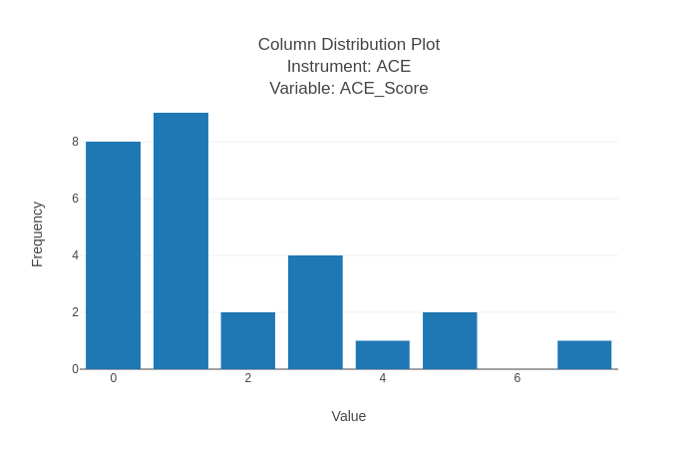
Aggregate
One to One
Agg. Distance Matrix | Agg. Eig. Vec. Heatmap | Agg. Scree Plot | Agg. Dendro. | Agg. Par. Coord. | Agg. 2D Embed. Scatter | Agg. Embed. Pairs | Spark Lines | Correl- ation Matrix | Coherence Matrix
Agg. Distance Matrix | Agg. Eig. Vec. Heatmap | Agg. Scree Plot | Agg. Dendro. | Agg. Par. Coord. | Agg. 2D Embed. Scatter | Agg. Embed. Pairs | Agg. NA Density | Agg. Column Historgam | 11/20
Agg. Distance Matrix | Agg. Eig. Vec. Heatmap | Agg. Scree Plot | Agg. Dendro. | Agg. Par. Coord. | Agg. 2D Embed. Scatter | Agg. Embed. Pairs | 11/20 ARMA Transition Matrix | 11/20 | 11/27
fMRI Pheno EEG

Slide 4
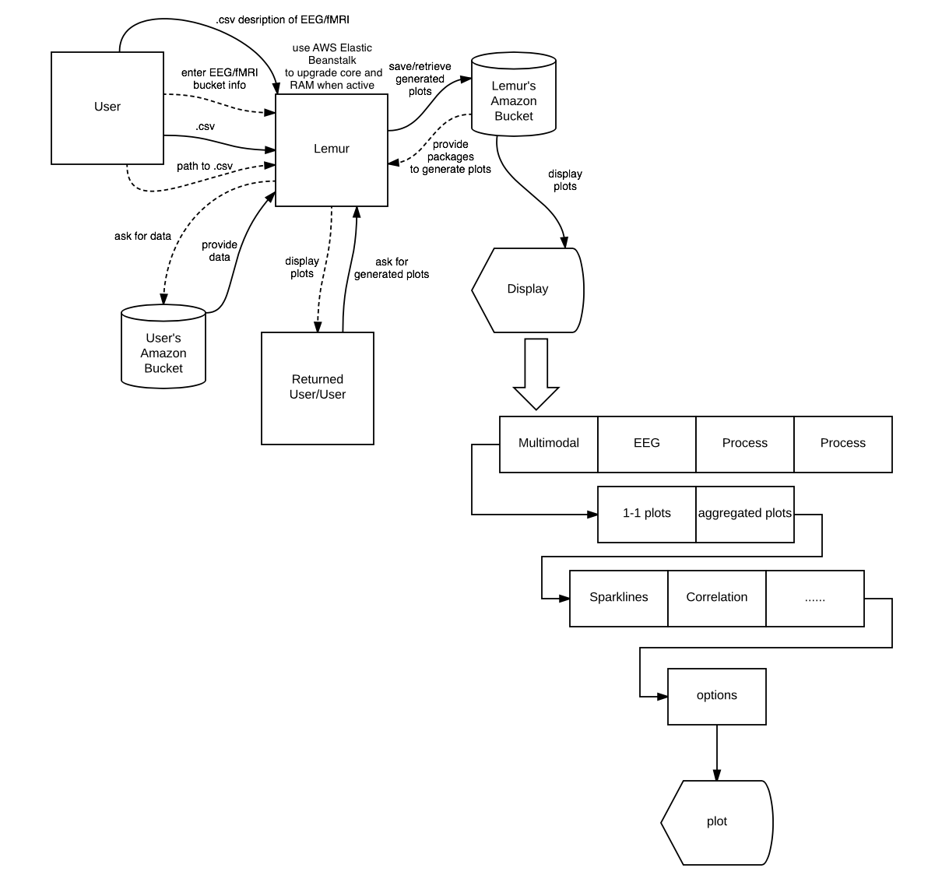
Web Service Flow
Chart

Slide 5
Work Focus
Exploring and implementing new visualizations
Ronak -- scopes and implements signal / time series parameterizations
Vidur -- implements visualizations and runs on real data to generate ideas for improvement
Ryan -- scopes and implements visualizations related to Phenotypic (high dimensional ordinal)
Lemur Web Service
Yujia, Ryan, Nitin

Slide 6
Next Week
Two connectivity based fMRI Plots
Radial plot based on connectivity of ROIs
Adjacency matrix based on connectivity of ROIs
Ability to plot ARMA Matrix for EEG
Flask app (running locally) where you can upload a .csv of Phenotypic Data and get all current plots
Algorithms.md for EFA, and run on the HBN data (‘Total’ or ‘Score’ columns only) to get our version of ‘p-factor’

Slide 7
Look at it: Lots of NA values in HBN Phenotypic

Slide 8
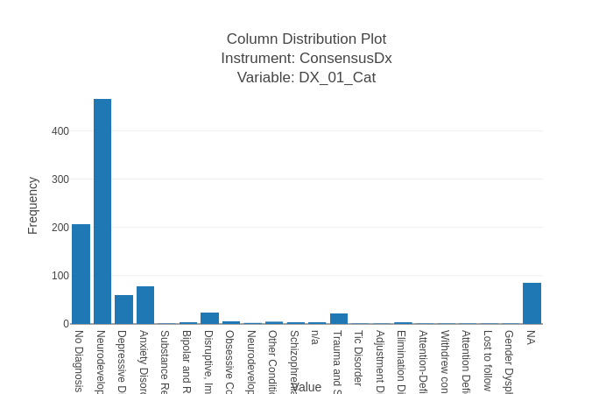
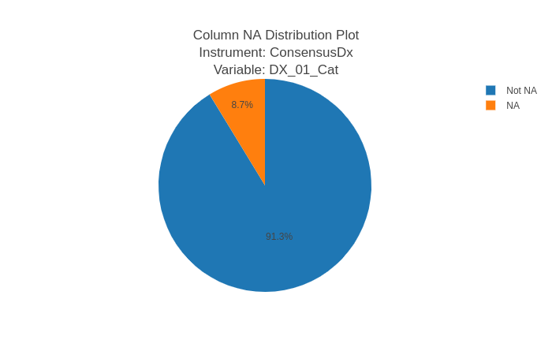
Look at it: Diagnostic Categories in HBN

Slide 9
Coherence Matrix

